Slide 1




CQRS with Erlang
presented by Bryan Hunter Firefly Logic
Twitter #erlang #cqrs
#ndcoslo
@bryan_hunter
@fireflylogic

Slide 2
?

Slide 3
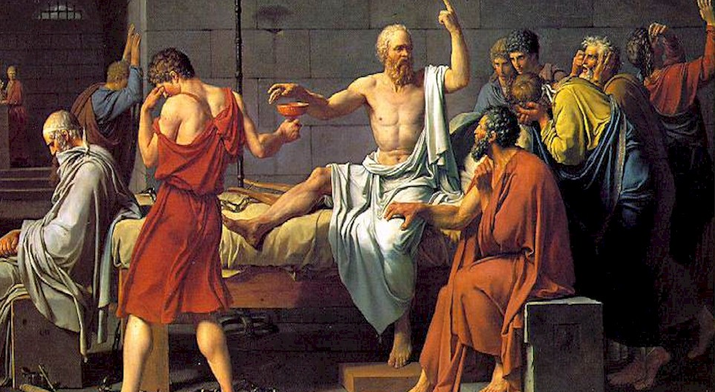
I’ll have one more of these… umm… what am I drinking?

Slide 4
What and why CQRS?

Slide 5
Command Query Responsibility Segregation
> What is CQRS?

Slide 6
CQRS is an architectural pattern
> What is CQRS?

Slide 7

Command Query Separation (CQS)
…applied to the “big”
void MutateSomeState(…); - or - MyResult GetWithoutTouching(…);
> What is CQRS?
Notes:
http://commons.wikimedia.org/wiki/File:Old_book_bindings.jpg

Slide 8
CQRS is about separating reads from writes
> What is CQRS?

Slide 9
CQRS is about heresy
> What is CQRS?

Slide 10
Why CQRS?

Slide 11

> Why CQRS?
Domain Driven Design
Your heart says “it’s the right thing”
…but your brain says “you’re a big stinkin’ fraud”

Slide 12
> Why CQRS?
Bog standard
Layered Architecture
(not CQRS)
SQL
ORM
“Aggregate”<T> ☺
Repository<T>
DTOs
Two way data binding
Client
ConcurrencyException
load()
{
this.DataSource = _service.GetData();
}
save()
{
_service.Save(this.Data); }
Notes:
TODO:

Slide 13

> How CQRS?
Task-based UI
Read store
Command

Slide 14
> How CQRS?
CQRS (as a cycle)
Events
Read-store
Command
Write-store
UI

Slide 15
> How CQRS?
Analytics store
CQRS (more details)
Event store
Queue
Read store
EventHandler
Event
EventHandler
EventHandler
Aggregate
Command Handler
DTO
Queue
Legacy store
Command
Client
Readonly
Command Builders
Tasks

Slide 16
> Why CQRS?
CQRS (roles)
Analytics store
Event store
Queue
Legacy store
Read store
EventHandler
Event
EventHandler
Aggregate
EventHandler
Command Handler
DTO
Queue
Command
Client
Readonly
Command Builders
Tasks

Slide 17
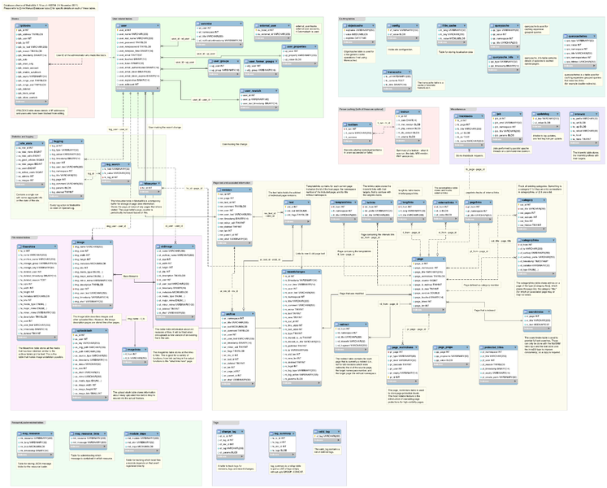
> Why CQRS?
keep your privates private

Slide 18

> Why CQRS?
returns focus to the business

Slide 19

> Why CQRS?
Vendor relationships should be consensual

Slide 20
> Why CQRS?
$
$
$
$
$
$
$
$
$
$
$
$
$
$
scaling up
scaling out
¢
¢
¢
¢
¢
¢
¢
¢
¢
¢

Slide 21

> Why CQRS?
SLAs? Explicit & tunable

Slide 22
> Why CQRS?
Let the business tweak CAP
Partition tolerant
Consistent
Available

Slide 23
> Why CQRS?
simplify conflicts, read-write contention, and concurrency
9
0
1
2
3
4
5
6
7
8
{moved, 200203, …}
{deposited, 21203, 100}
{loanOfferSent, 200203}
{deposited, 21203, 100}
{deposited, 21203, 100}
{deposited, 200203, 1000}
{accountCreated, 21203}
{overdrafted, 200203, 50}
{withdrawn, 200203, 350}

Slide 24
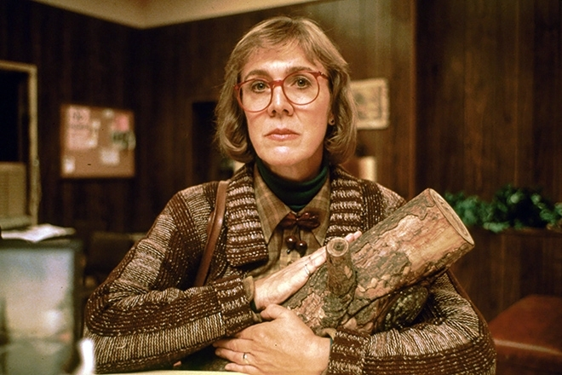
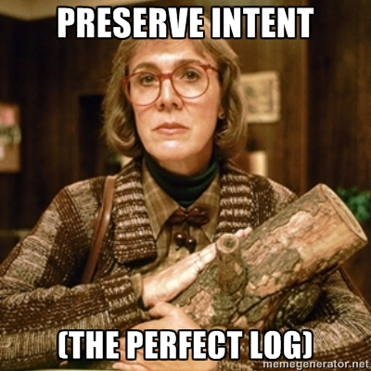
> Why CQRS?
http://memegenerator.net/Twin-Peaks-Log-Lady

Slide 25

> Why CQRS?
Our one chance to
to get it right
Big Design Upfront YAGNI Just-in-Time
Future-proof Maintenance

Slide 26
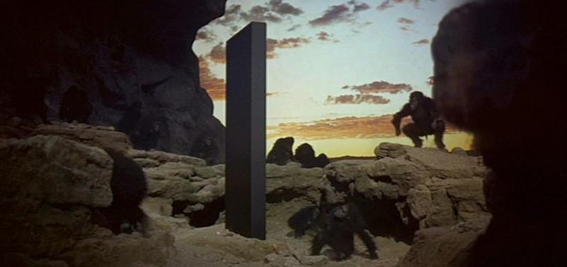
> Why CQRS?
Monoliths typically aren’t this helpful
Predictive analytics
mission-critical 24/7 3,000 TPS
Monthly batch
MVC & Entity Framework
Active-record smart-UI
Ad-hoc SQL

Slide 27
Why Erlang?

Slide 28
> Why Erlang?
Erlang is open, proven and cross-platform. It simplifies writing reliable, concurrent, distributed systems. Its pattern matching is FTW.

Slide 29
Erlang Runtime System (in-context)
.NET dev stack
Erlang dev stack
C# / F#
Erlang / Elixir
.NET Framework
OTP
250+ years
CLR
ERTS
VM + Kernel
+ STDLIB
OS (Windows)
OS (Windows, Linux, Mac, None)

Slide 30
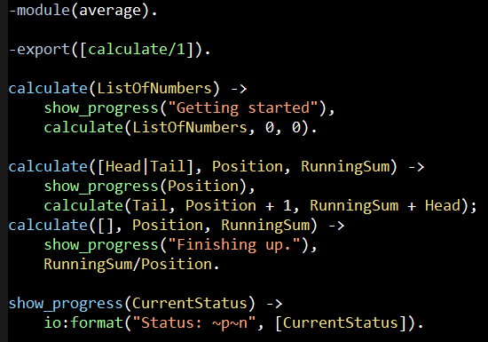
Erlang (the Language)
File: average.erl

Slide 31
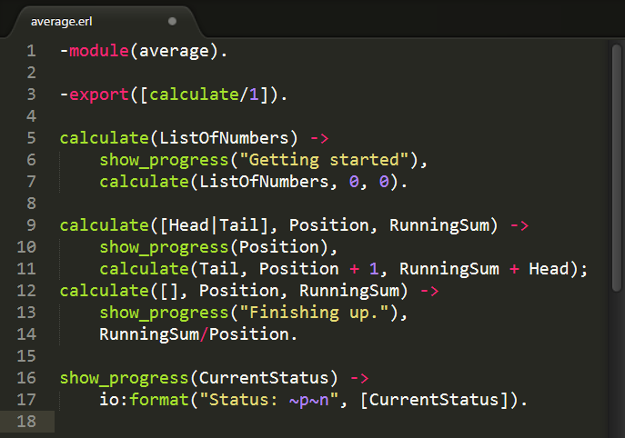
Notes:
First let’s look at the filename of this source file. It is “average” dot E-R-L.
“E-R-L” (pronounced “Earl”) is the file extension for Erlang source code files.

Slide 32
Notes:
Also notice the “module” attribute. This line declares an Erlang module named “average”.
The module name and the filename (less the extension) must match.
Each “erl” file contains a single module, and at compile time each module is compiled into it’s own “BEAM” file.
BEAM files are byte code that Erlang VM understands and can execute.
In our example compiling “average.erl” would produce a binary file named “average.beam”

Slide 33
Notes:
In the next line we have an “export” attribute which specifies which functions defined within the module will be visible outside the module.
In this case we are exporting a single function named calculate that has an arity of one.
If the term “arity” is new to you it simply means the number of arguments a functions takes.
So here we are saying: in this module, there is function named “calculate” that take one argument, and we want to make that function public.
Any other functions declared in the module will be private since they aren’t exported.

Slide 34
Notes:
Next, let’s take note of the how the code is broken up.
A module consists of a sequence of attributes and then function declarations, each terminated by period (.)

Slide 35
Notes:
Lets look at the first function: “calculate” with an arity of one. This is one public function defined in the module.

Slide 36
Notes:
The function is name calculate

Slide 37
Notes:
It takes a single argument named “ListOfNumber”.

Slide 38
Notes:
Our function body begins with an arrow…

Slide 39
Notes:
And ends with the period

Slide 40
{
}
Notes:
If you are coming from a curly brace language the “arrow” is our left curly brace and the “period” is your closing curly brace.

Slide 41
Notes:
Within a function each statement is “delimited” by a comma.
Note I said each statement within a function is “delimited” by a comma, not “terminated” by a comma.
If you’re coming from a curly brace language this will take a week or so to really get used to.
It might help to think of English where a series of words is delimited by commas.

Slide 42
Notes:
OK, so what is going on here?

Slide 43
Notes:
Note the semicolon. In Erlang semicolons delimit clauses.

Slide 44
Notes:
At first look like two functions named “calculate” with an arity of three, but it’s actually a single function with two clauses.
This is our first real taste of Erlang pattern-matching.

Slide 45
[5,10,15], 0, 0
Notes:
If this function is called and the first argument is a list that contains at least one element then execution will fall into this function clause.
The “Head” variable will be bound to the first element on the list, and the “Tail” variable will be bound to the reminder of the list (everything after the head).

Slide 46
Notes:
Another concept demonstrated here is tail recursion. The last statement in this function clause is a call to itself.
Tail recursive multi-headed functions are a common idiom in Erlang and is used in places where looping structures might be used in other languages.

Slide 47
[], 3,30
Notes:
If however the first argument isn’t a list with a head and a tail then execution will fall into the second function clause.

Slide 48
Notes:
Another interesting point is the absence of a “return” statement.
The value of the last statement in a function is the return value of the function.

Slide 49
Notes:
Finally this is the syntax for external calls– or calling a function in another module. In this case we are calling the “format” function within the “io” module.

Slide 50
“The performance
of a concurrent language
is predicated by three things:
the context switching time,
The message passing time,
and the time to create a process.”
–Mike Williams

Slide 51
One Java 6 or .NET 4.0 Thread (allocates one megabyte)
**********
**********
**********
**********
**********
**********
**********
**********
**********
**********
**********
**********
**********
**********
**********
**********
**********
**********
**********
**********
**********
**********
**********
**********
**********
**********
**********
**********
**********
**********
**********
**********
**********
**********
**********
**********
**********
**********
**********
**********
**********
**********
**********
**********
**********
**********
**********
**********
**********
**********
Heap
Mailbox
Stack
**********
**********
**********
**********
**********
**********
**********
**********
**********
**********
**********
**********
**********
**********
**********
**********
**********
**********
**********
**********
**********
**********
**********
**********
**********
**********
**********
**********
**********
**********
**********
**********
**********
**********
**********
**********
**********
**********
**********
**********
**********
**********
**********
**********
**********
**********
**********
**********
**********
**********
Garbage Collector
Links and Monitors
One Erlang Process (allocates one kilobyte)
*
Why -> elsewhere concurrency is painful

Slide 52
*
*
*
Reductions
- Do 2,000 operations
reduction1 reduction3 .
Reduction2000
- Move to the next guy - Repeat
CPU Core
Why -> near zero context switching cost

Slide 53
worker
supervisor
*
*
CPU Core
Why -> supervision

Slide 54
***** *****
***** *****
***** *****
***** *****
Core
Core
Core
Core
Why -> elsewhere concurrency is painful

Slide 55
Concurrency and Parallelism

Slide 56
Why?
1986
2006
≠
Concurrency
Parallelism
structure
execution
lots of things at once

Slide 57
Concurrency-Oriented Programming
Imperative
Declarative

Slide 58

Distribution: built-in from the start

Slide 59



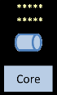
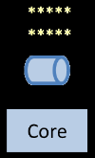
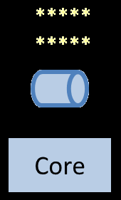

Slide 60
net_adm:ping(node10)
net_adm:ping(node9)
net_adm:ping(node8)
net_adm:ping(node7)
net_adm:ping(node6)
net_adm:ping(node5)
net_adm:ping(node4)
net_adm:ping(node3)
net_adm:ping(node2)

Slide 61
> Why CQRS?
OTP
gen_server
gen_fsm
gen_event
application
supervisor

Slide 62
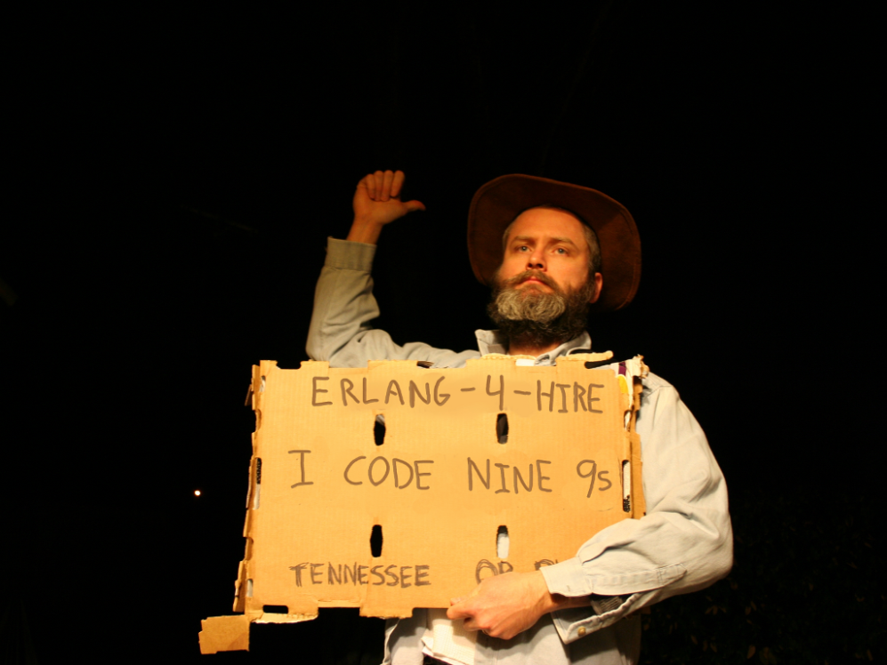
Nines | Uptime | Annual Downtime
9 | 99.9999999% | 30 milliseconds
8 | 99.9999990% | 300 milliseconds
7 | 99.9999900% | 3 seconds
6 | 99.9999000% | 32 seconds
5 | 99.9990000% | 5 minutes
4 | 99.9900000% | 53 minutes
3 | 99.9000000% | 8 hours, 46 minutes
2 | 99.0000000% | 3 days, 15 hours, 36 minutes
Safe
Supervisor
Worker
Worker
Links and monitors
No masters
Hot code loading
simple distribution, safe concurrency
Why -> reliability

Slide 63
[insert awe-inspiring demo here]
Notes:
http://www.dccomics.com/tv/super-friends-1973-1974

Slide 64
> Why CQRS?
Dovetailing
Aggregate
actor, process, gen_fsm, distributed actor
Command & Event Handlers
gen_event
Commands & Events
Messages, pattern-matching
FP & Eventsourcing
Immutability, functional composition

Slide 65














When you reach for CQRS
are you solving problems
that led these companies…
to
…to
?
Notes:
Horizontally scalable reads
Dialing SLA

Slide 66


http://subscriptions.viddler.com/GregYoung
How -> watch some videos

Slide 67

“Learn You Some Erlang for Great Good!” http://learnyousomeerlang.com/
How -> read this excellent and free online book

Slide 68



Start here
How -> read some books

Slide 69
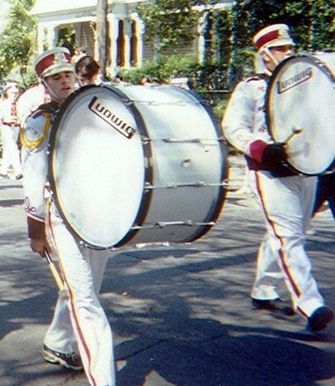


Start a polyglot FP group
λ
λ
http://nashfp.org
How -> Better yet; pack up and move to Nashville!

Slide 70
Thanks!
Bryan Hunter
Twitter: @bryan_hunter
Email: bryan.hunter@fireflylogic.com
Firefly Logic, Inc.
1000 Main Street #201 Nashville, TN 37206
http://fireflylogic.com
> keep in touch

